Slide 1
Mr. Hernandez
ESL Multi-Level Class
Delano Adult School

Slide 2
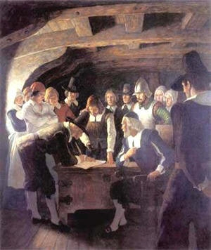
Review of Past Lesson
*Europeans came to America for Power, Money, &
Religion. Colonies like Jamestown & Plymouth were
Started.
*As pilgrims came to Plymouth, they created a social
Contract (Mayflower Compact) that helped them create
a government outside of England. Sparked Ideas for
the Future.
*England went into debt defending the 13 colonies from
The French & Indian War. England began to tax the colonies
to help with debt.
*Colonist became angered with the King’s taxes so in 1775 the
American Revolution began and a year later (1776) colonists
created and signed the Declaration of Independence.

Slide 3
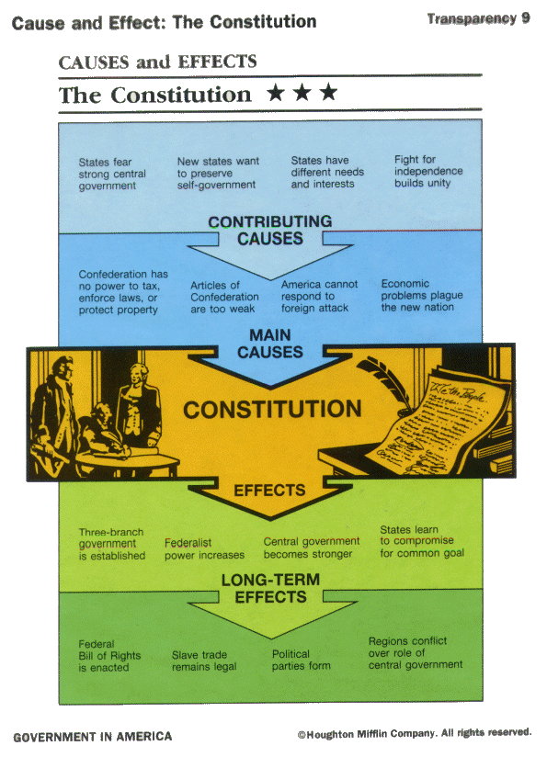
Review of Past Lesson
*During the Revolutionary war, Americans began to work on a government that states would abide by. They came up with the Articles of confederation, but soon realized that they were too weak and it gave too much power to the states.
Where do we go from her?

Slide 4
Road to the Constitution
New Jersey Plan - “Small States”
Branches | 3 braches-legislative, executive, Judicial. The legislature appoints people to serve in the executive branch, and executive branch selects the justices for the Supreme Court.
Legislature | One house. States represented equally so all states had the same power.
Other Power | The government could tax & import duties, regulate trade, and state laws would be secondary to laws passed be national government.
*1787 – After the Articles of Confederation had failed, every state but Rhode Island sent delegates to the Constitutional Convention in Philadelphia. George Washington was named president of the convention.
Main Issues to Resolve
Big States- Edmund Randolph proposed the “Virginia Plan.” This plan asked for a new type of government, which included an executive, a judiciary, and a legislature made up of two houses (Senate & House of Representatives) and including a number of representatives from each state based on population.
Small States-Smaller states feared the Virginia Plan because big states would have power in the legislature. William Patterson proposed “New Jersey Plan,” which revised the Article of Confederation and gave an equal vote to each state.
*After much debate, the members of the Constitutional Convention rejected the New Jersey Plan, and decide to work toward a new government
Virginia Plan – “Big States”
Branches | 3 branches – legislative, executive, & judicial. Legislative more powerful because it chose the people to serve in the executive & judicial branches.
Legislature | 2 houses: The House of Representatives elected by the people & the Senate was elected by the state legislatures. Both were elected based on population.
Other Powers | Legislature could regulate interstate trade, strike down laws that were unconstitutional and use armed forces to enforce laws.

Slide 5
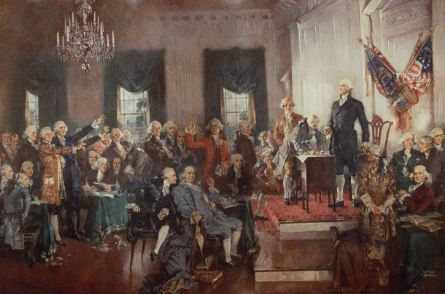
Road to the constitution continued…
Another issue at the Constitutional Convention was of hot debate was the issue of slavery.
*3/5 Compromise – This agreement reached by Southern and Northern states at the Constitutional Convention said that slaves were counted as 3/5 of a human being for the purpose of taxation and representation in Congress.
These issues became important parts in the way the Constitution was made. The founding fathers had to worked on taking ideas from all these issues to develop the Constitution. The issue of two houses for the legislature had a huge impact and Roger Sherman was helpful in framing the “Connecticut Compromise.” This plan suggested representation in the lower house (House of Representatives) based on population and equal representation in the upper house (The Senate).
With these ideas and compromises set in place, the convention was able to complete a draft of a constitution. Soon after a final draft was written and the convention approved the Constitution on September 17, 1787.

Slide 6
Show Me What You Know? Use the clues to fill in what you know about the creation of the Constitution. We will review together in 10 minutes.
Plan for Big States?
Plan for Small States?
Plan to Settle Slave Issue?
How Many Houses & how were reps elected?
How many Branches and what was their power?
Other Powers?
How Many Houses & how were reps elected?
How many Branches and what was their power?
Other Powers?
What was the worth of a slave?
How this this make it fair for northern states?
As a result, what compromise helped the convention agree on a draft? What were the ideas behind the compromise? What was the end result and what day & year did the convention approve it?

Slide 7
Show Me What You Know? Use the clues to fill in what you know about the creation of the Constitution. We will review together in 10 minutes.
Plan for Big States?
Virginia Plan
Plan for Small States?
New Jersey
Plan to Settle Slave Issue?
3/5 Compromise
How Many Houses & how were reps elected? 2 Houses (House of Representatives & Senate. Representatives would be elected based on state’s population.
How many branches and what was their power? 3 branches: legislative, executive, & judicial. Legislative more powerful because it chose the people to serve in the executive & judicial branches.
Other Powers? Legislature could regulate interstate trade, strike down laws that were unconstitutional and use armed forces to enforce laws.
How Many Houses & how were reps elected? 1 House and reps were elected equally.
How many branches and what was their power? 3 braches: legislative, executive, Judicial. The legislature appoints people to serve in the executive branch, and executive branch selects the justices for the Supreme Court.
Other Powers? The government could tax & import duties, regulate trade, and state laws would be secondary to laws passed be national government.
What was the worth of a slave? Slaves were counted as 3/5 of a human being .
How did this make it fair for northern states? Bigger population in the South so this would balance issue of taxation and representation in Congress.
As a result, what compromise helped the convention agree on a draft? What were the ideas behind the compromise? What was the end result and what day & year did the convention approve it? The Connecticut Compromise helped the framers of the Constitution come to an agreement. This plan suggested representation in the lower house (House of Representatives) based on population and equal representation in the upper house (The Senate). The end result was the draft of the Constitution that was approved by the Constitutional convention on September 17, 1787.

Slide 8
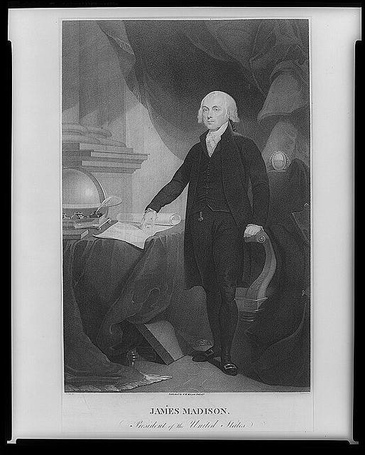
Protecting Peoples’ Rights: The Bill of Rights
*As the constitution had been approved many people still feared that the government would take advantage of their rights.
*James Madison helped create what became known as the Bill of Rights. The Bill of rights were introduced as 12 amendments, but in 1791 Congress approved 10 amendments that would be added to the constitution.
Bill of Rights
Amendment I – Freedom of Expression
Amendment II – Right To bear Arms
Amendment III – Quartering Troops
Amendment IV – Unreasonable Search & Seizures
Amendment V – Due Process of Law
Amendment VI – Right to A Fair Trial
Amendment VII – Trial By Jury
Amendment VIII – Cruel & Unusual Punishment
Amendment IX – Rights to the People – Unenumerated Rights
Amendment X – Rights to the States

Slide 9
Now It’s Your Turn Using the information that you have received, partner up with someone and make a Bill of Rights Book. This book should include a title page, and ten pages that gives the name of the amendment, portrays an illustration of the amendment, and gives a brief description of the amendment. The book will be made on the computer and then printed out to present to the class. You can use Google, http://government.mrdonn.org/billofrights.html, or http://ratify.constitutioncenter.org/constitution/details_explanation.php?link=154&const=16_amd_09 to do your research and get pictures. The following is a sample of what you can do:
Bill of Rights 1791 Student Names Close Up Region 5 | Amendment 1 (picture) Brief description of Amendment | Amendment 2 (picture) Brief description of Amendment | Amendment 3 (picture) Brief description of Amendment | Amendment 4 (picture) Brief description of Amendment
Amendment 5 (picture) Brief description of Amendment | Amendment 6 (picture) Brief description of Amendment | Amendment 7 (picture) Brief description of Amendment | Amendment 8 (picture) Brief description of Amendment | Amendment 9 (picture) Brief description of Amendment
Amendment 10 (picture) Brief description of Amendment

