Slide 2
Road to the Constitution
New Jersey Plan - “Small States”
Branches | 3 braches-legislative, executive, Judicial. The legislature appoints people to serve in the executive branch, and executive branch selects the justices for the Supreme Court.
Legislature | One house. States represented equally so all states had the same power.
Other Power | The government could tax & import duties, regulate trade, and state laws would be secondary to laws passed be national government.
Virginia Plan – “Big States”
Branches | 3 branches – legislative, executive, & judicial. Legislative more powerful because it chose the people to serve in the executive & judicial branches.
Legislature | 2 houses: The House of Representatives elected by the people & the Senate was elected by the state legislatures. Both were elected based on population.
Other Powers | Legislature could regulate interstate trade, strike down laws that were unconstitutional and use armed forces to enforce laws.
*3/5 Compromise – This agreement reached by Southern and Northern states at the Constitutional Convention said that slaves were counted as 3/5 of a human being for the purpose of taxation and representation in Congress.
These issues became important parts in the way the Constitution was made. The founding fathers had to worked on taking ideas from all these issues to develop the Constitution. The issue of two houses for the legislature had a huge impact and Roger Sherman was helpful in framing the “Connecticut Compromise.” This plan suggested representation in the lower house (House of Representatives) based on population and equal representation in the upper house (The Senate).
With these ideas and compromises set in place, the convention was able to complete a draft of a constitution. Soon after a final draft was written and the convention approved the Constitution on September 17, 1787.

Slide 3
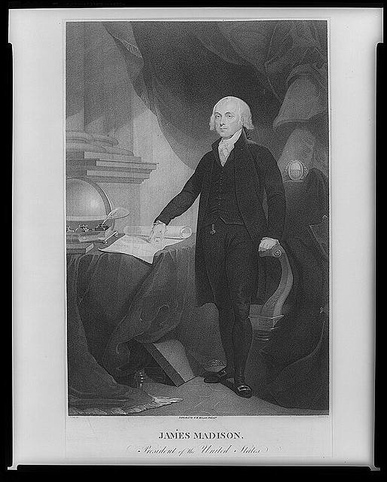
Protecting Peoples’ Rights: The Bill of Rights
*As the constitution had been approved many people still feared that the government would take advantage of their rights.
*James Madison helped create what became known as the Bill of Rights. The Bill of rights were introduced as 12 amendments, but in 1791 Congress approved 10 amendments that would be added to the constitution.
Bill of Rights
Amendment I – Freedom of Expression
Amendment II – Right To bear Arms
Amendment III – Quartering Troops
Amendment IV – Unreasonable Search & Seizures
Amendment V – Due Process of Law
Amendment VI – Right to A Fair Trial
Amendment VII – Trial By Jury
Amendment VIII – Cruel & Unusual Punishment
Amendment IX – Rights to the People – Unenumerated Rights
Amendment X – Rights to the States
James Madison
Developed the “Bill of Rights”

Slide 4
The Constitution
The constitution includes a preamble, seven articles, and twenty-seven amendments. In this activity you will pair up with two other classmates and you will need to give a brief explanation as to how each article is divided up and what it talks about. The following website: http://ratify.constitutioncenter.org/constitution/details_explanation.php?link=003&const=00_pre_00 will help you with your research to get the information you need. I have done the preamble for you so you know what is expected. Divide the work evenly so that you can finish in a timely manner. When complete your research, your group will report your information to your classmates.
Preamble
Brief Explanation
The Preamble of the US Constitution is the an introductory passage that tells the purpose of the Constitution. The small passage details how Americans wanted to secure their freedom under a new form of government.

Slide 5
The Constitution
Brief Explanation
How many sections?
What does it talk about?
Article 1

Slide 6
The Constitution
Brief Explanation
How many sections?
What does it talk about?
Article 2

Slide 7
The Constitution
Brief Explanation
How many sections?
What does it talk about?
Article 3

Slide 8
The Constitution
Brief Explanation
How many sections?
What does it talk about?
Article 4

Slide 9
The Constitution
Brief Explanation
How many sections?
What does it talk about?
Article 5

Slide 10
The Constitution
Brief Explanation
How many sections?
What does it talk about?
Article 6

Slide 11
The Constitution
Brief Explanation
How many sections?
What does it talk about?
Article 7

Slide 12
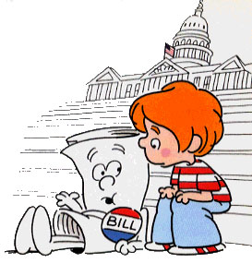
The Three Branches of Government
The first three articles of the US Constitution talks about the duties and responsibilities of the three Branches of Government. Each branch has a specific duty and the founding fathers made sure that no branch of government became too powerful by creating a “Checks & Balance” system. A “Checks and Balance” was created so that the powers of the central government were separated instead of having one person or group having all the power. The “Checks and Balance” system gives each branch of the Federal Government a way to check, or control the other two branches. For Instance the, the way a Bill becomes a law is a good example of how each branch checks and balances their power:

Slide 13
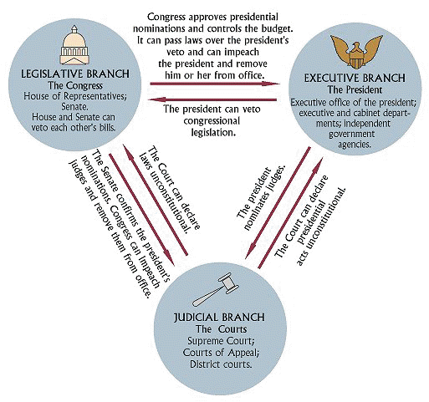
The Three Branches of Government

Slide 14
The Three Branches of Government
Work with a partner to gather the needed information about each Branch o Government. Use the following website to gather the information needed: http://library.thinkquest.org/J0110221/
Legislative Branch
Headed By:
Number of Terms Served & Number of Representatives:
Qualifications:
Duties:
Executive Branch
Headed By:
Number of Terms Served:
Qualifications:
Duties:
Judicial Branch
Headed By:
Number of Terms Served:
Qualifications:
Duties:

Slide 15
The Three Branches of Government
Work with a partner to gather the needed information about each Branch o Government. Use the following website to gather the information needed: http://library.thinkquest.org/J0110221/
Legislative Branch
Headed By:
House of Representatives &
Senate
Number of Terms Served & Number of Representatives:
House of Reps – 2 year Terms & 435 Reps
Senate – 6 year Terms & 50 Senators
Qualifications:
Representatives: 25 years old, US Citizen for 7 years, & resident of the state representing for a year.
Senators: 30 years old, US Citizen for 9 years, and resident of the state representing for a year.
Duties: They write bills to become laws
Executive Branch
Headed By: President
Number of Terms Served:
Two terms of 4 years a total of 8 years
Qualifications: 35 years old, natural born citizen, & lived in the US for 14 years
Duties: President signs bills into laws or vetos them, require reports from departments, makes treaties, & appoints officials of the USA,
Judicial Branch
Headed By: Supreme Court – Chief Justice
Number of Terms Served & Number of Justices: Justices do not have a term limit (serve for life) and there are 9 Supreme Court Justices
Qualifications: Chief Justices are appointed by the president and are approved by congress. They make sure the president has appointed a qualified person for the job
Duties: They explain (interpret) and apply the laws we live by.

